Slide 1
Spalart-Allmaras Turbulence Model
Mech 588 – Advanced Topics in CFD
Christian Rowsell
March 27th, 2023

Slide 2
Agenda
Background
Goals in developing the model
Mathematical description
Boundary conditions
Benefits of this model
Shortcomings of this model
Question period

Slide 3
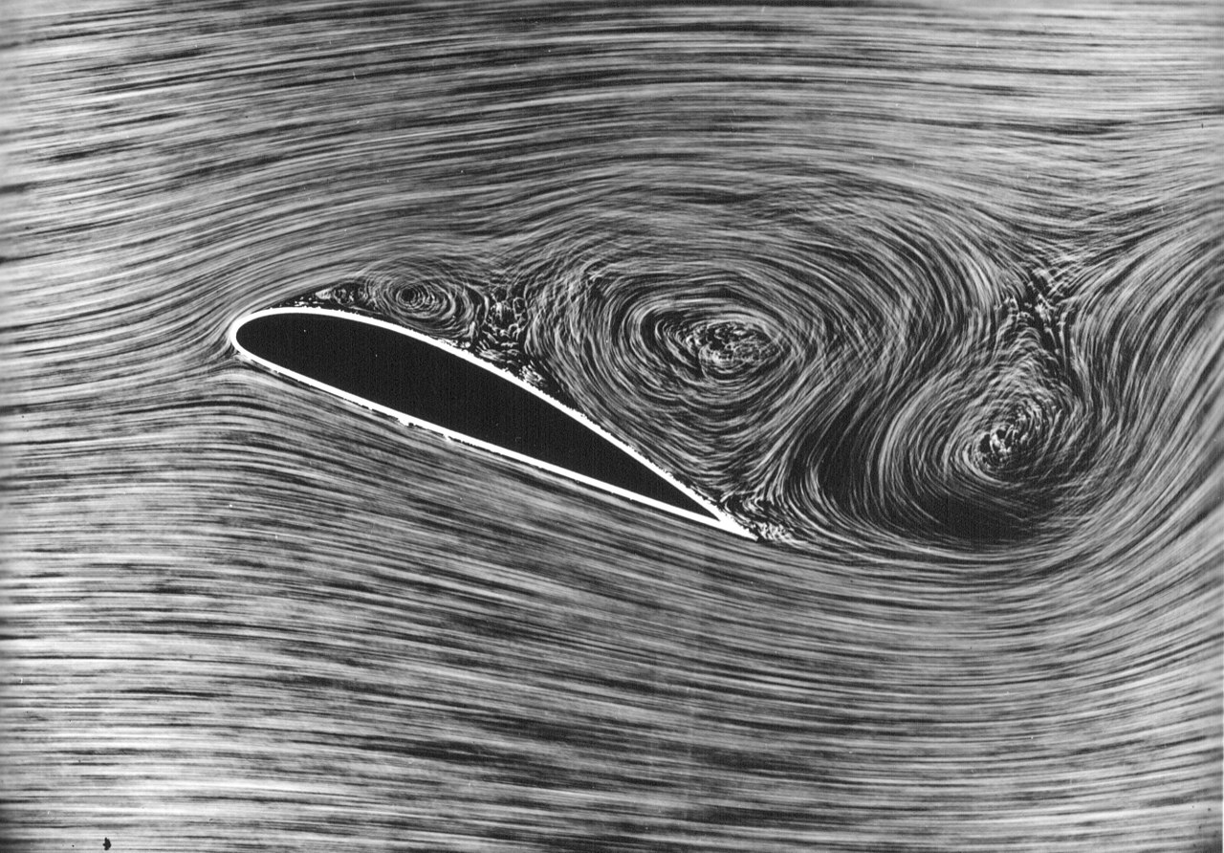
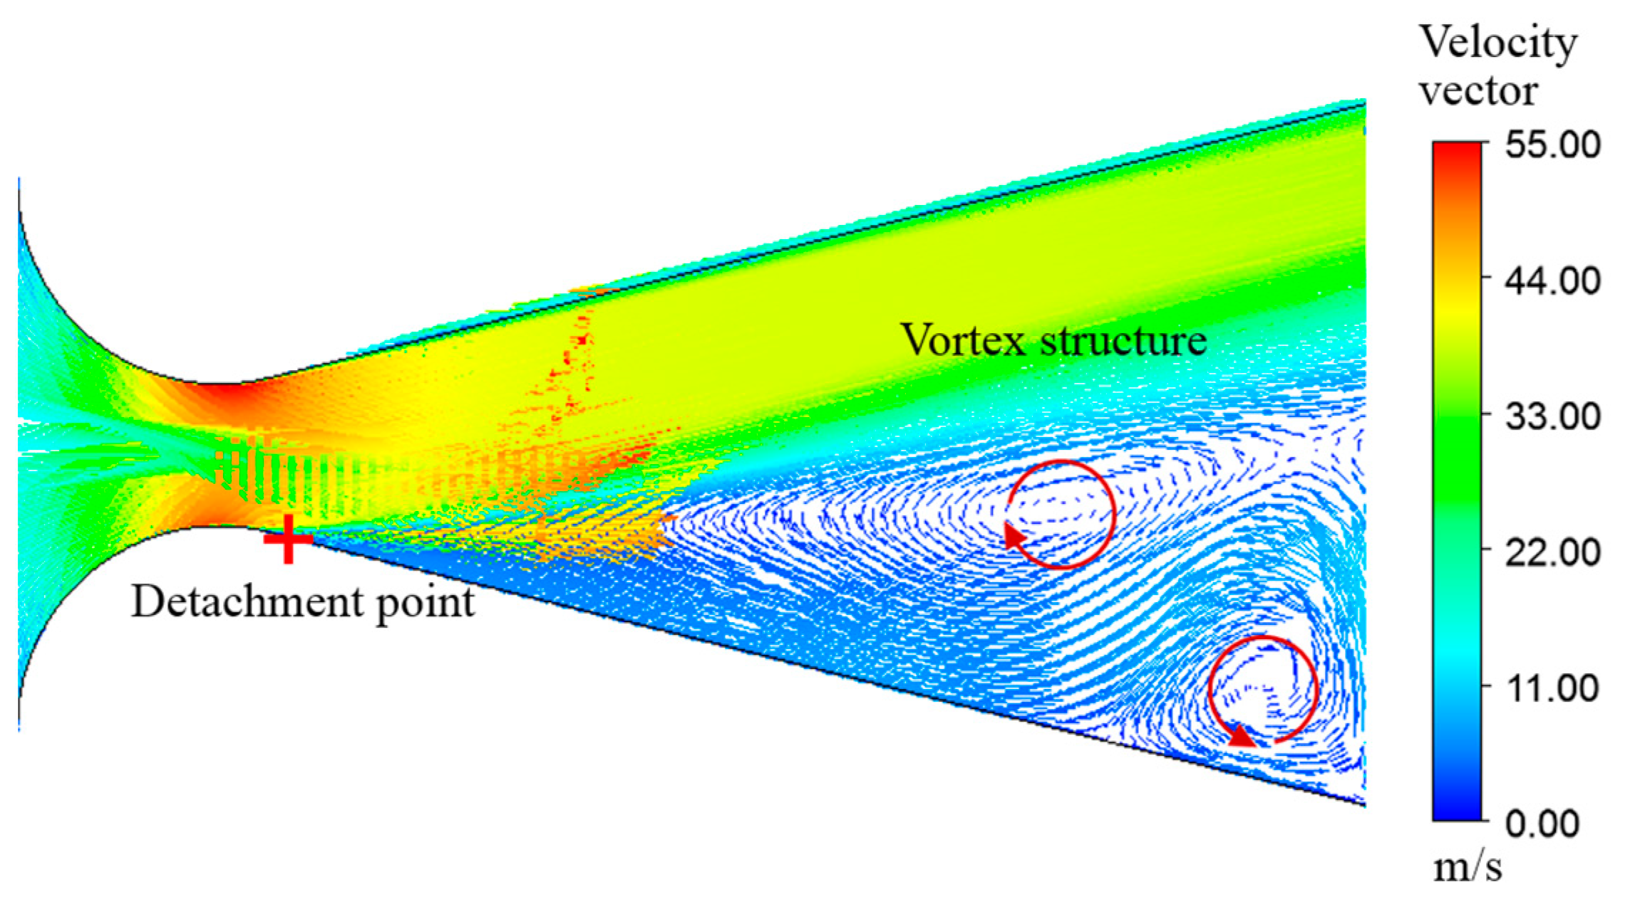
Background
In 1973, the k-ε turbulence model was developed.
This model worked well for the most part, but it was determined to give inaccurate results for boundary layer flows with adverse pressure gradients.
This was especially true when shocks became present in the flow.
A new model was needed for aerodynamic flows, such as flow over wings, and turbomachinery.
Separated flow over an airfoil [1]
Separated flow in a diffuser [4]

Slide 4
Background (cont)
In 1988, the k-ω turbulence model was developed.
In 1994 this turbulence model was further worked upon, and the k-ω SST model was developed.
At the same time as these models were being developed, P. R. Spalart, and S.R. Allmaras were working at Boeing.
Boeing asked them to develop a turbulence model which would be more suitable for the aerodynamic flows faced in aircraft design.
In 1994, the same year as the k-ω SST model was developed, the Spalart-Allmaras turbulence model was also developed.
All of these models aimed to better describe the boundary layer when inverse pressure gradients were present.

Slide 5
Goals in Developing the Model
Of course the main goal of the model was to better predict flow separation, and boundary layer flows given a flow with adverse pressure gradients.
They also developed with the following goals in mind,
    Applicable to unstructured and multi-block meshes.
    Minimal complexity in applying boundary conditions.
    Minimize computational cost.

Slide 6
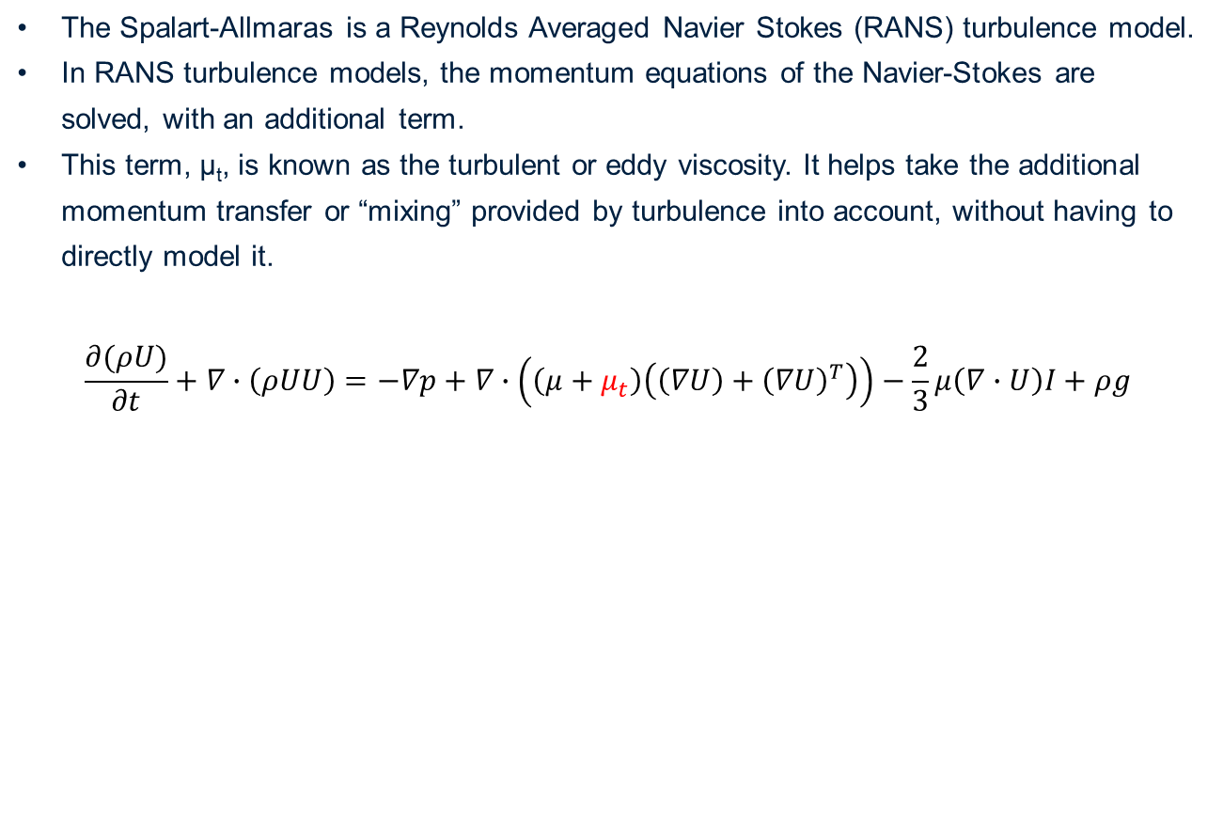
Mathematical Description
The Spalart-Allmaras is a Reynolds Averaged Navier Stokes (RANS) turbulence model.
In RANS turbulence models, the momentum equations of the Navier-Stokes are solved, with an additional term.
This term, μ_{t}, is known as the turbulent or eddy viscosity. It helps take the additional momentum transfer or “mixing” provided by turbulence into account, without having to directly model it.
$$\frac{∂(ρU)}{∂t}+∇∙\left(ρUU\right)=−∇p+∇∙\left(\left(μ+μ_{t}\right)\left(\left(∇U\right)+{\left(∇U\right)}^{T}\right)\right)−\frac{2}{3}μ\left(∇∙U\right)I+ρg$$
Turbulent Viscosity

Slide 7
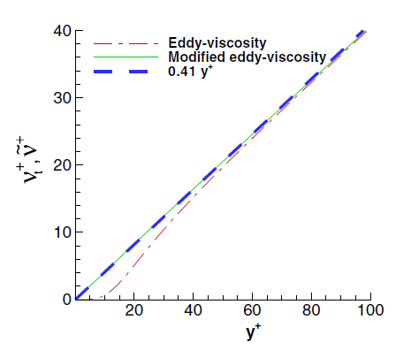
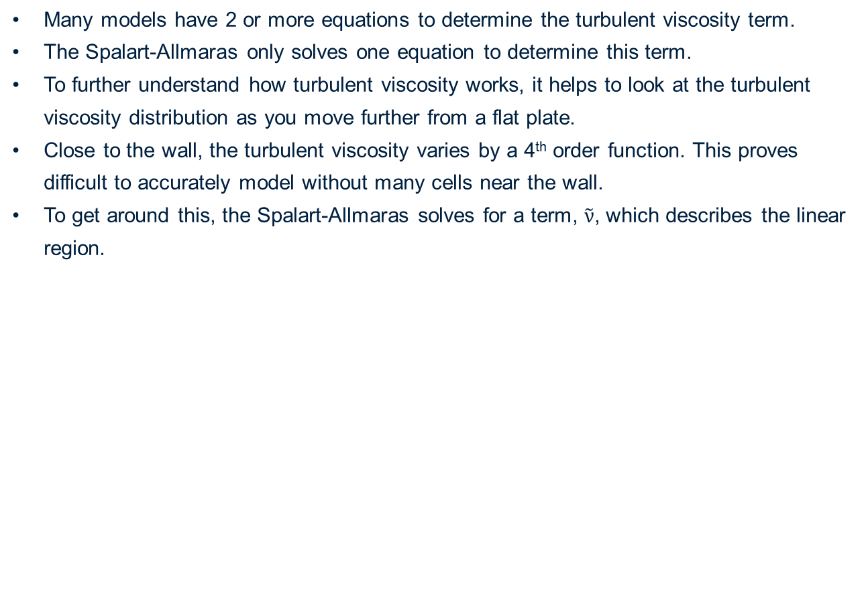

Turbulent Viscosity
Many models have 2 or more equations to determine the turbulent viscosity term.
The Spalart-Allmaras only solves one equation to determine this term.
To further understand how turbulent viscosity works, it helps to look at the turbulent viscosity distribution as you move further from a flat plate.
Close to the wall, the turbulent viscosity varies by a 4th order function. This proves difficult to accurately model without many cells near the wall.
To get around this, the Spalart-Allmaras solves for a term, $\tilde{ν}$, which describes the linear region.
Linear Distribution
$$\tilde{ν}$$
Distribution varies with (y⁺)⁴
Turbulent viscosity variation as the normal distance from the wall increases [4]

Slide 8
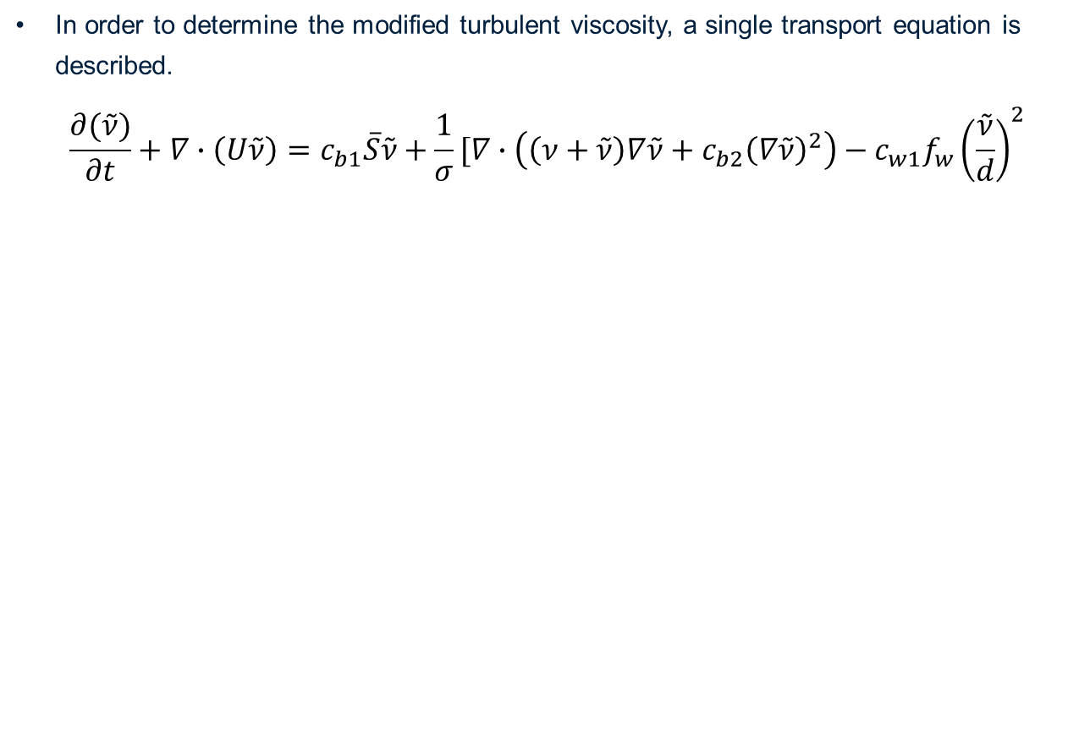
Modified Turbulent Viscosity
In order to determine the modified turbulent viscosity, a single transport equation is described.
$$\frac{∂(\tilde{ν})}{∂t}+∇∙\left(U\tilde{ν}\right)=c_{b1}\overline{S}\tilde{ν}+\frac{1}{σ}[∇∙\left(\left(ν+\tilde{ν}\right)∇\tilde{ν}+c_{b2}{\left(∇\tilde{ν}\right)}^{2}\right)−c_{w1}f_{w}{\left(\frac{\tilde{ν}}{d}\right)}^{2}$$
Convective Term
This non-linear term was added by the authors to control the “spreading” of the turbulent viscosity, resulting in a more accurate wake profile.
Destruction term
Turbulence Produced by Shear (S represents the shear rate tensor)
Diffusion Term
Notes:
In the paper the following values are given, however the author states there is a range of acceptable values
Sigma – 2/3
Cb1 – 0.1355
Cb2 – 0.622
The non-linear term was calibrated using experimental data.
The non-linear term is often treated as a source term.
d in the destruction term represents the distance to the nearest wall.
As you approach the wall, turbulence is destroyed by viscosity and inviscid blocking. The destructor term takes this into account. As d approaches 0, fw also approaches 0, preventing divide by 0 errors.

Slide 9
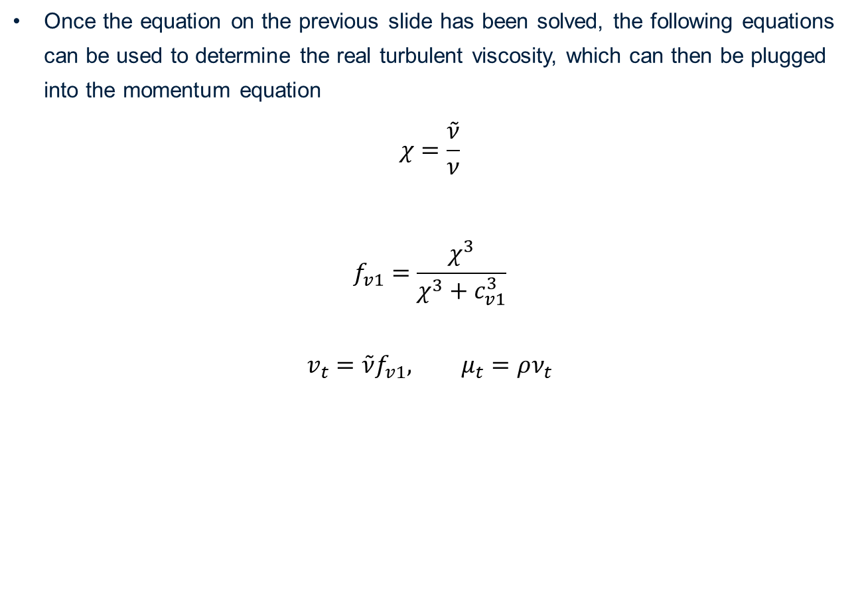
Solving for real turbulent viscosity
Once the equation on the previous slide has been solved, the following equations can be used to determine the real turbulent viscosity, which can then be plugged into the momentum equation
$$χ=\frac{\tilde{ν}}{ν}$$
$$f_{v1}=\frac{χ^{3}}{χ^{3}+c_{v1}^{3}}$$
$$v_{t}=\tilde{ν}f_{v1}, μ_{t}=ρν_{t}$$
Notes:
The destructor term on the previous slide only covers inviscid turbulence destruction. The fv1 term shown here imposes the viscous turbulence destruction. Remember when we previously showed that near the wall, the turbulent viscosity had a 4th order profile, but we approximated it with a linear function in the modified turbulent viscosity. This function fv1 imposes the 4th order solution on the turbulent viscosity, which near the wall results in viscous destruction of turbulence. Further away from the wall, the modified turbulent viscosity approaches the flow viscosity, resulting in a linear profile again.

Slide 10
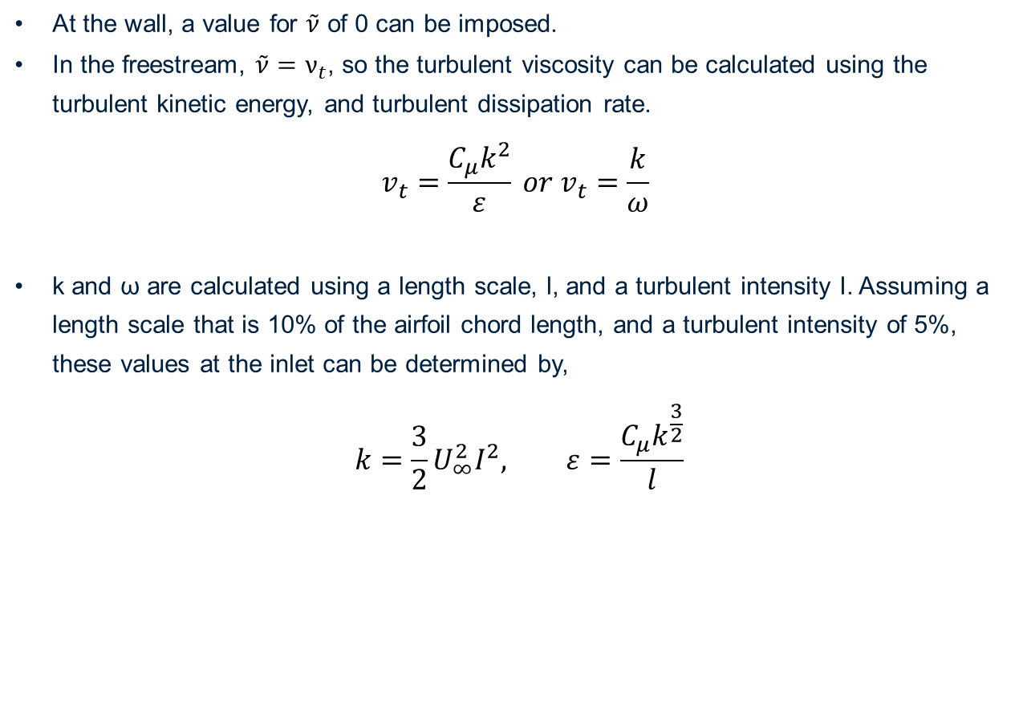
Boundary conditions
At the wall, a value for $\tilde{ν}$ of 0 can be imposed.
In the freestream, $\tilde{ν}=ν_{t}$, so the turbulent viscosity can be calculated using the turbulent kinetic energy, and turbulent dissipation rate.
$$v_{t}=\frac{C_{μ}k^{2}}{ε} or v_{t}=\frac{k}{ω}$$
k and ω are calculated using a length scale, l, and a turbulent intensity I. Assuming a length scale that is 10% of the airfoil chord length, and a turbulent intensity of 5%, these values at the inlet can be determined by,
$$k=\frac{3}{2}U_{∞}^{2}I^{2}, ε=\frac{C_{μ}k^{\frac{3}{2}}}{l}$$

Slide 11
Benefits of this Model
This model proved to give much better results for boundary layer flows subjected to adverse pressure gradients than previous models did.
This model is local. That is, solving for the turbulent viscosity happens independently for each cell. This leads to ease of use for unstructured, or multi-block grids.
This model only has 1 transport equation to solve for the turbulent viscosity. This improves computational efficiency.
Due to the linear nature of the modified turbulent viscosity, this model shows good convergence.
The boundary conditions for this model are simple to apply.

Slide 12
Shortcomings of this Model
This model tends to under predict flow separation, and often does not predict flow separation in the correct location on the airfoil.
This model does not predict flow reattachment post-shock on an airfoil well.
This model does not define turbulence length and time scales as well as other models, such as k-ω SST.

Slide 13
Questions

Slide 14
References
[1] - “Flow separation,” Wikipedia, 11-Jun-2022. [Online].
Available: https://en.wikipedia.org/wiki/Flow_separation. [Accessed: 26-Mar-2023].
[2] - G. Kalitzin, G. Medic, G. Iaccarino, and P. Durbin,
“Near-wall behavior of Rans Turbulence models and implications for wall functions,”
Journal of Computational Physics, vol. 204, no. 1, pp. 265–291, 2005.
[3] - P. SPALART and S. ALLMARAS, “A one-equation turbulence model for aerodynamic flows,”
30th Aerospace Sciences Meeting and Exhibit, 1992.
[4] - X. Meng, Z. Zuo, M. Nishi, and S. Liu, “A numerical study on the flow mechanism of
performance improvement of a wide-angle diffuser by inserting a short splitter Vane,”
Processes, vol. 8, no. 2, p. 143, 2020.

